Slide 1

Deep Learning-Based Facial Landmark Detection Using Modified ResNet-18
A computer vision approach for robust 68-point facial keypoint detection
Team Members:
Vaishnavi Verma(22P31A05B8)
Anushka Rajput(22P31A0578)
Pallab Mondal(22P31A05B5)
Challa Bhargav(22P31A0584)
Project Guide:
Dr. R S V Lalitha
M. Tech , Ph.d

Slide 2
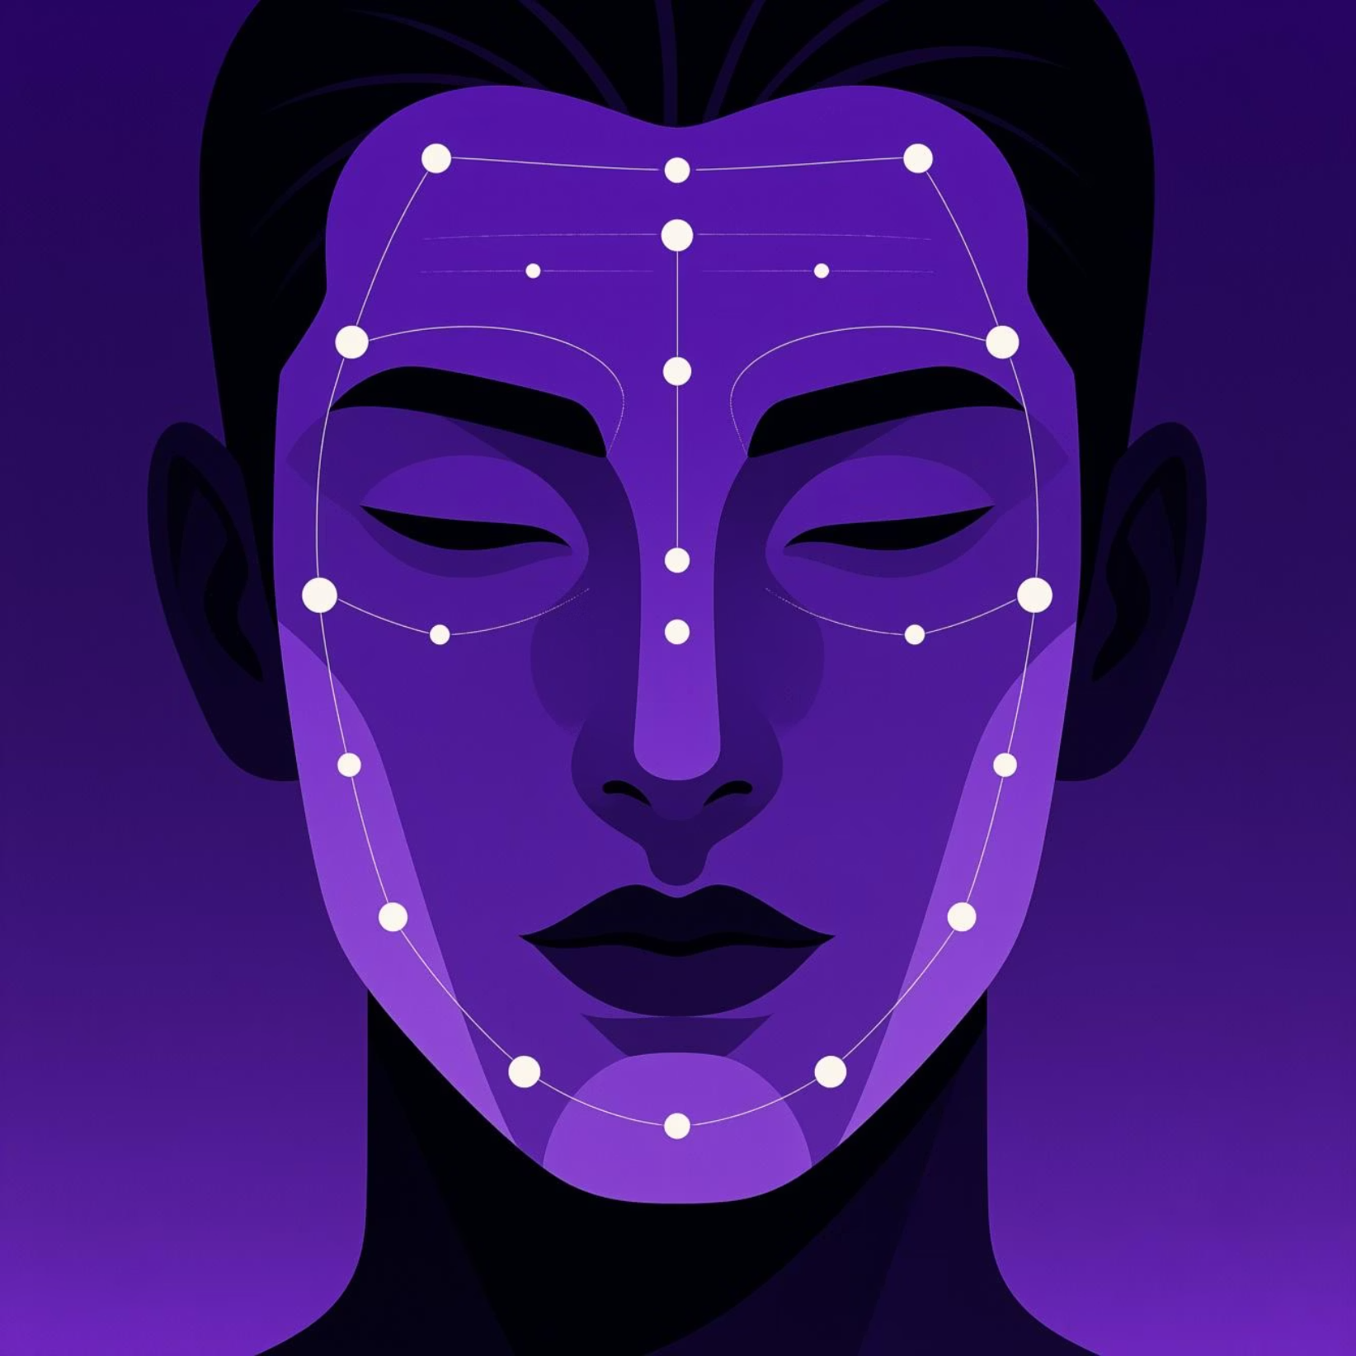
Abstract
Facial landmark detection is fundamental to applications like facial recognition, emotion detection, and augmented reality. This project develops a deep learning model using modified ResNet-18 architecture to predict 68 facial landmark points directly from grayscale images.
Our CNN-based approach learns discriminative facial features automatically, addressing key challenges including lighting variations, pose changes, and occlusions. Early results demonstrate improved prediction stability, reduced preprocessing requirements, and superior generalization compared to traditional handcrafted-feature methods.

Slide 3
Research Keywords
Deep Learning
Facial Landmark Detection
Neural network architectures for computer vision
68-point keypoint identification
ResNet-18
CNNs
Modified residual network architecture
Convolutional neural networks
Computer Vision
Feature Extraction
Image Processing
Visual data processing and analysis
Hierarchical representation learning
Preprocessing and normalization pipelines

Slide 4





Introduction: Understanding Facial Landmarks
Facial landmark detection identifies essential facial keypoints including eyes, eyebrows, nose, mouth, and jawline. These landmarks form the foundation for advanced computer vision applications.
Face Recognition
Emotion Analysis
Head-Pose Estimation
Identity verification and authentication systems
Detecting and classifying facial expressions
Tracking orientation and gaze direction
Augmented Reality
3D Reconstruction
Real-time face filters and overlays
Building three-dimensional face models
Deep learning approaches have revolutionized landmark prediction by automatically learning hierarchical feature representations directly from raw images.

Slide 5

Problem Statement
Traditional facial landmark detection methods depend on handcrafted features like HOG, SIFT, and cascaded regression techniques. These approaches face critical limitations in real-world scenarios:
Illumination Sensitivity
Pose Variations
Occlusion Handling
Poor performance under low light or varying lighting conditions, leading to inaccurate landmark predictions
Significant accuracy loss during extreme head rotations or non-frontal face angles
Inability to handle partial face occlusions from hands, glasses, hair, or accessories
Expression Instability
Detection Dependency
Inconsistent results with complex or extreme facial expressions
Heavy reliance on precise face detection as a preprocessing step
Project Goal: Develop a robust, accurate, and generalizable deep learning model that detects 68 facial landmarks reliably under diverse real-world conditions.

Slide 6
Related Work & Literature Review
Active Shape & Appearance Models
1
ASM and AAM approaches rely on statistical shape and appearance information. While pioneering, these methods offer limited robustness under challenging conditions.
2
Cascaded Regression Models
Fast inference but highly sensitive to pose variations and lighting changes. Performance degrades significantly outside controlled environments.
CNN-Based Approaches
3
VGG and AlexNet variants improved accuracy substantially but require significant computational resources, making real-time deployment challenging.
4
ResNet-Based Solutions
Deeper networks with skip connections enable better feature extraction and gradient flow, achieving state-of-the-art performance with manageable complexity.
Research Gap Identified
Many existing models require extensive preprocessing, struggle with occlusions, and lack consistent performance under varying environmental conditions. Our approach addresses these limitations.
5

Slide 7




Proposed Methodology
Our system employs a modified ResNet-18 architecture optimized for facial landmark regression. The model processes grayscale facial images and outputs 136 coordinate values representing 68 keypoints.
01
02
03
Grayscale Conversion
Image Preprocessing
Landmark Normalization
Convert RGB images to single-channel grayscale to reduce complexity while preserving facial structure
Resize to fixed 224×224 dimensions and normalize pixel values to [0,1] range
Scale coordinate values relative to image dimensions for consistent learning
04
05
Feature Extraction
Coordinate Regression
Modified ResNet-18 extracts hierarchical features using residual connections
Fully connected layer outputs 136 values (x, y coordinates for 68 points)
Lightweight & Fast
Robust Features
Real-World Ready
Minimal Preprocessing

Slide 8






System Architecture
Modified ResNet-18 Model Components
Input Image
Raw facial photograph
Grayscale
Convolutional Layers
Multiple conv layers with BatchNorm and ReLU activation for feature learning
Single-channel conversion
Preprocessing
Residual Blocks
Resize & normalize
Skip connections preserve gradient flow and enable deeper network training
ResNet-18
Global Average Pooling
Reduces spatial dimensions while maintaining feature richness
Feature extraction
FC Layer
Regression Head
Coordinate output
Fully connected layer outputs 136 continuous values for landmark coordinates
68 Landmarks
Final predictions

Slide 9
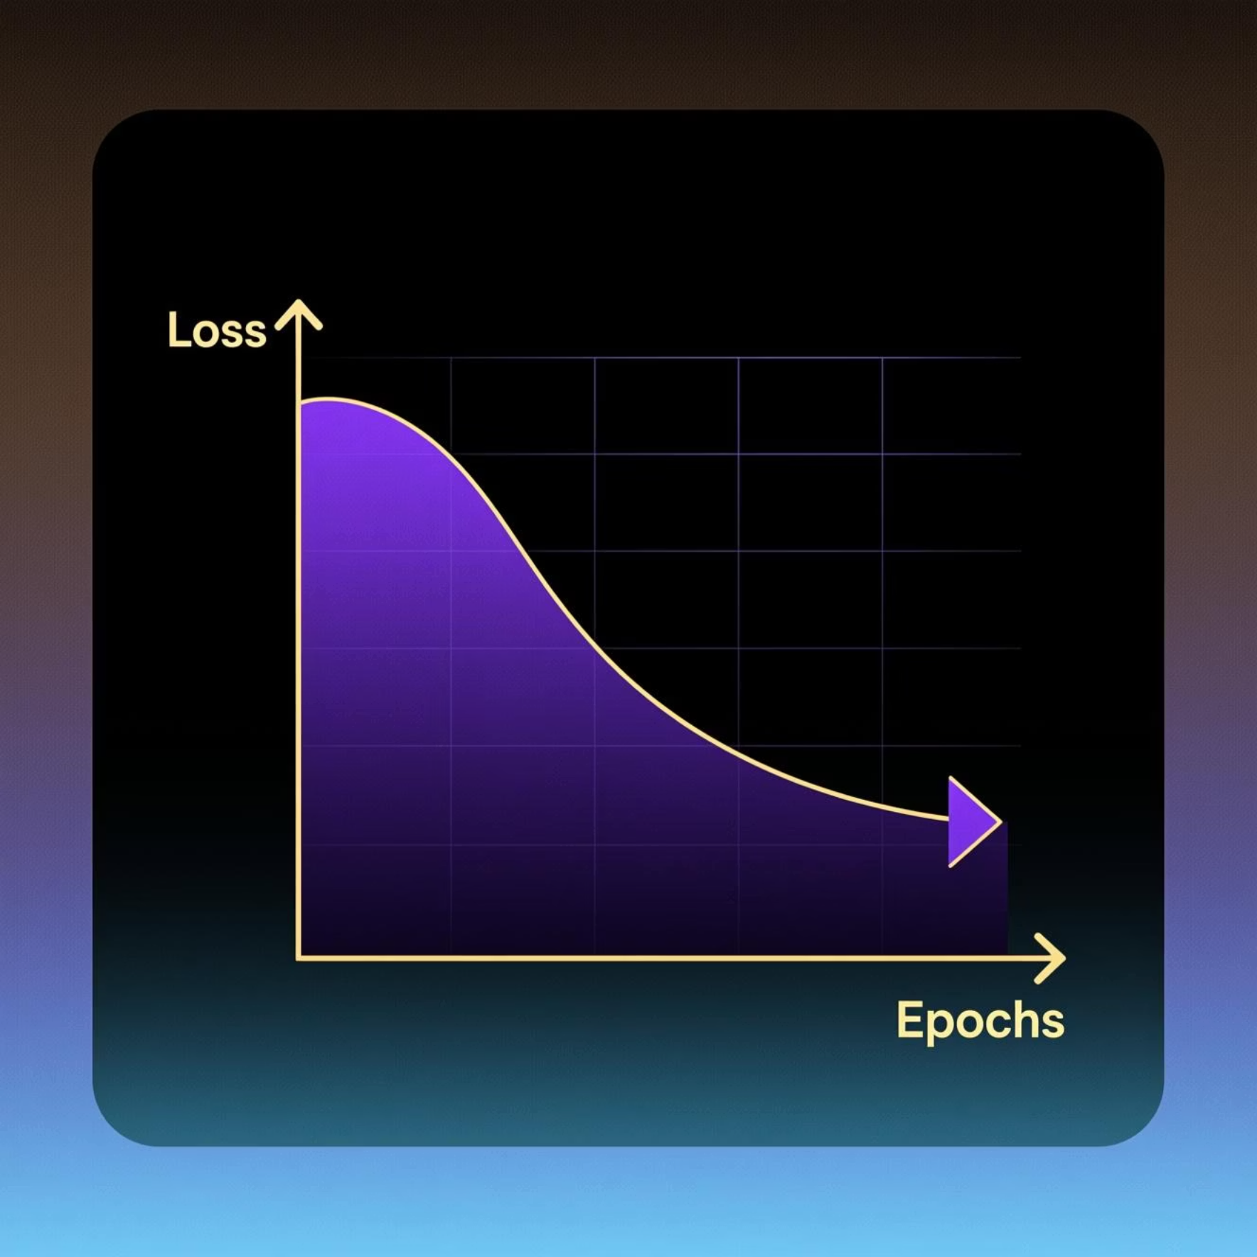





Proof of Concept Implementation
The foundational implementation demonstrates successful pipeline construction and initial model validation:
Dataset Selection
300-W dataset with 68 facial landmarks chosen for comprehensive training and evaluation
Preprocessing Pipeline
Complete implementation: grayscale conversion, resizing, normalization, and .pts landmark file parsing
Data Loader Built
TensorFlow data pipeline successfully configured for efficient batch processing
Model Architecture
ResNet-18 structure implemented with modified regression head for landmark prediction
Initial Training
Training initiated on sample dataset showing correct learning patterns with decreasing loss
Validation Success
Model correctly overfits small samples (10-20 images)
Confirms proper implementation and learning capability
Loss curves show expected convergence behavior

Slide 10
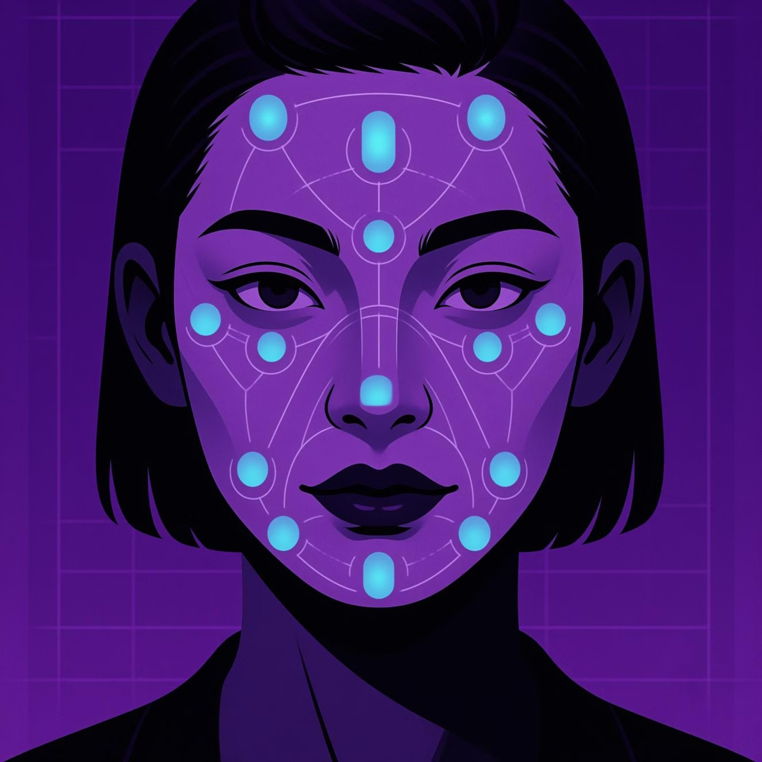

Current Results & Future Directions
Achievements So Far
Successful Overfitting Test
Model memorizes small sample correctly, validating architecture
Consistent Loss Reduction
Training loss improves steadily across epochs
Approximate Accuracy
Landmarks predicted near correct positions on test images
Pipeline Validation
Complete preprocessing workflow verified and operational
Next Steps & Planned Evaluation
1
2
3
Full Dataset Training
Quantitative Metrics
Visual Validation
Train on complete 300-W dataset for comprehensive learning
Evaluate using MSE and Normalized Mean Error (NME) benchmarks
Generate visualizations of predicted landmarks overlaid on test images
4
5
Baseline Comparison
Real-Time Optimization
Compare performance against traditional and competing deep learning methods
Hyperparameter tuning and inference optimization for deployment
Conclusion: A robust foundation for 68-point facial landmark detection has been established using modified ResNet-18. The project successfully addresses traditional method limitations through deep learning. Future work focuses on complete model training, rigorous evaluation, and real-time deployment optimization.

Slide 11


